Slide 1

ArtHouseOnline Project
Phoenıx team
Merve Cavlı (181805083)
Muhammet Ali Ilgaz (171805017)
Samet Solak (191805106)

Slide 2
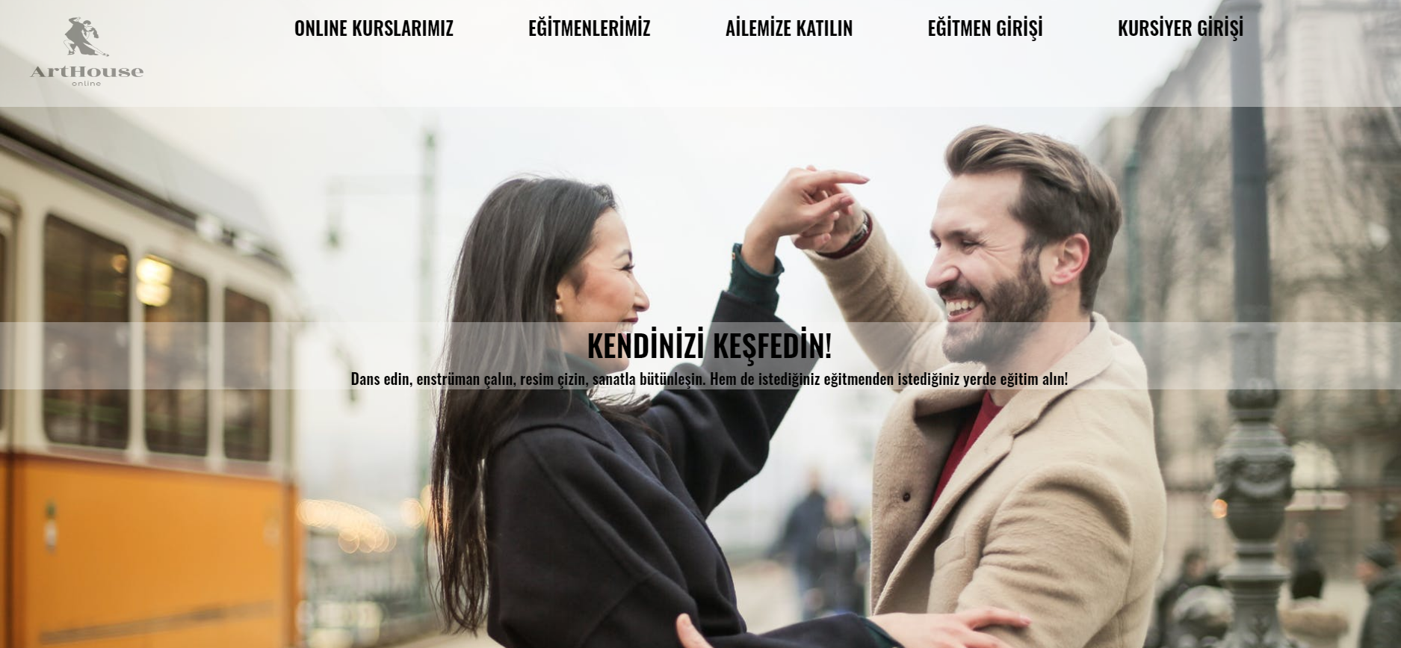
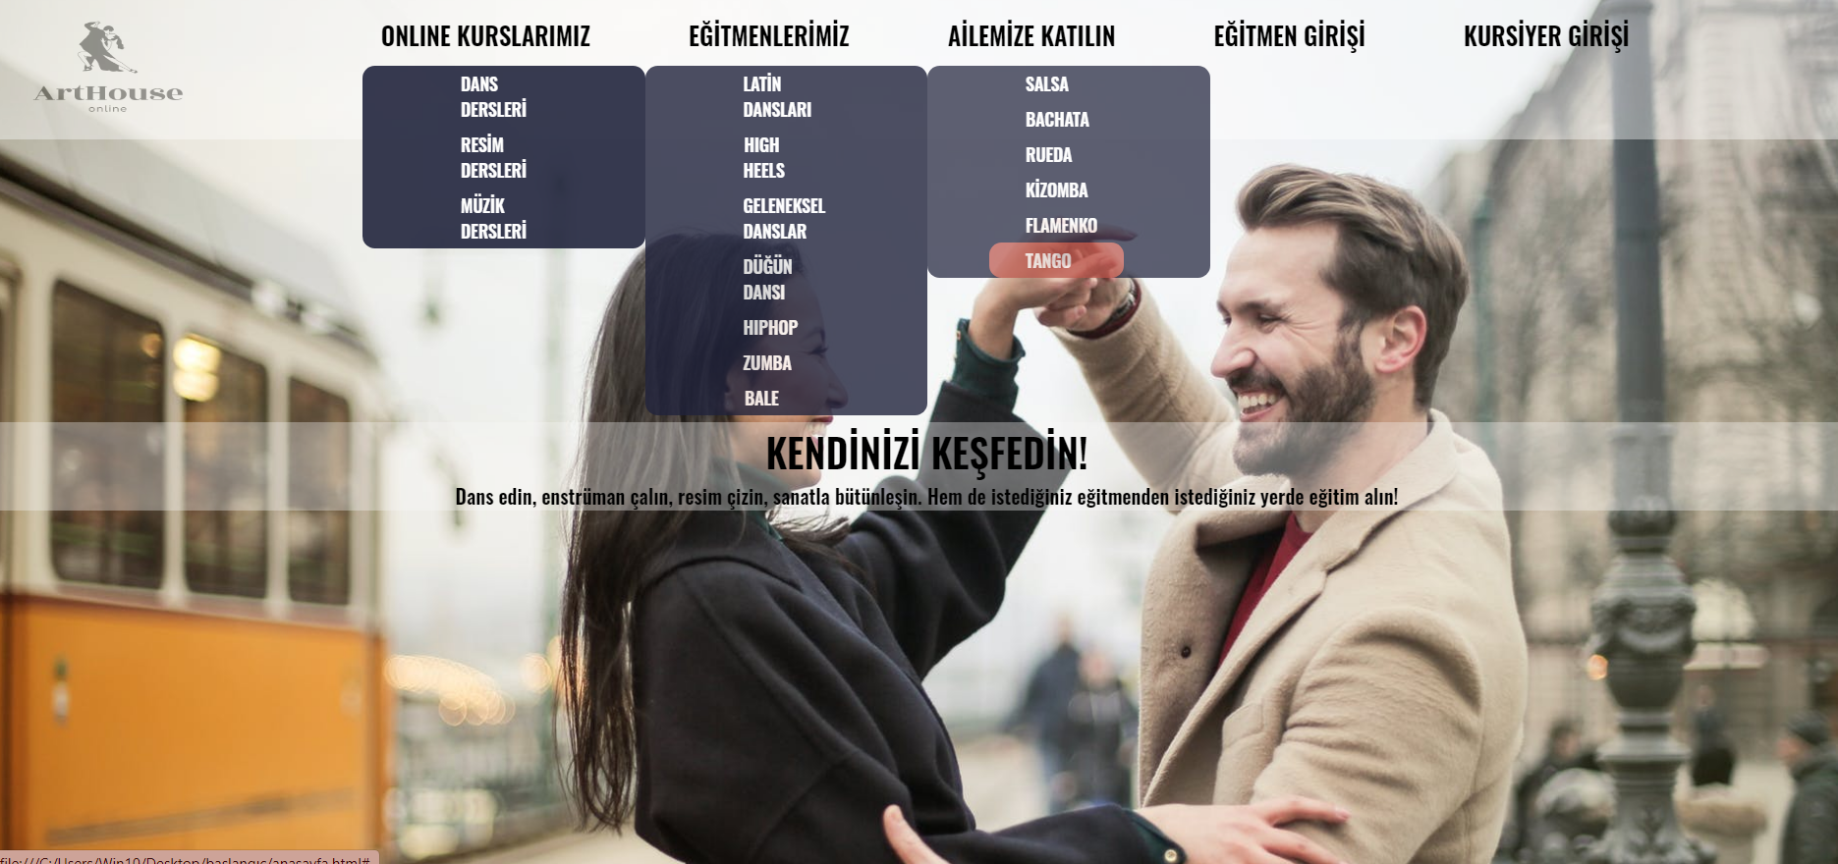
What Is Our Project About?
“ArtHouseOnline” is a website that can be used by everyone, easily. There are so many course options on the website such as dance, painting, music; and there are subbranches for them too.

Slide 3
Goals of the project
1- Giving people a hobby.
2- Generalizing art because it helps people.
3- Enabling people to improve themselves during the pandemic.
4- Enabling teachers to reach more students.

Slide 4
Users in the project and their needs
There are 3 types of user in the project. These are;
1- Student
2- Instructor
3- System Administrator
Their needs:
1- Both Students and Instructors need to create their profile.
2- Students want to see lots of course types in the system.
2.1 - Want to search course what they want to learn.
2.2 - Can want to add favorites to buy later.
3- Instructors want to add a new course.
3.1- Can want to earn money from students.

Slide 5
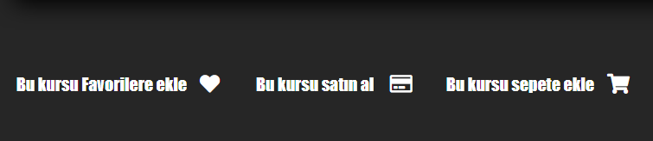
Main Functional Requirements
For Students:
1- Buy courses
2- Add courses to favorites

Slide 6
Main Functional Requirements
For Instructors:
1- Add course
2- Give a price tag

Slide 7
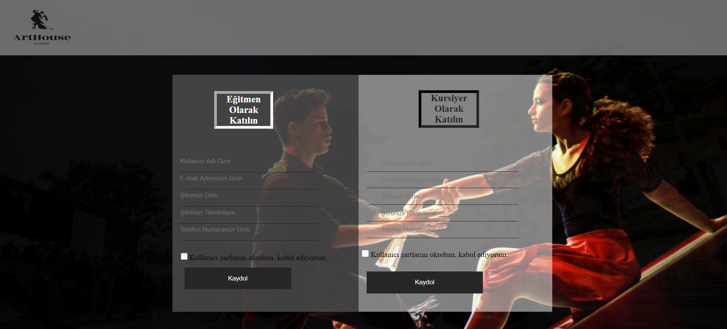
Main Functional Requirements
For Both Students and Instructors:
1- Set up profiles
2- Log In

Slide 8
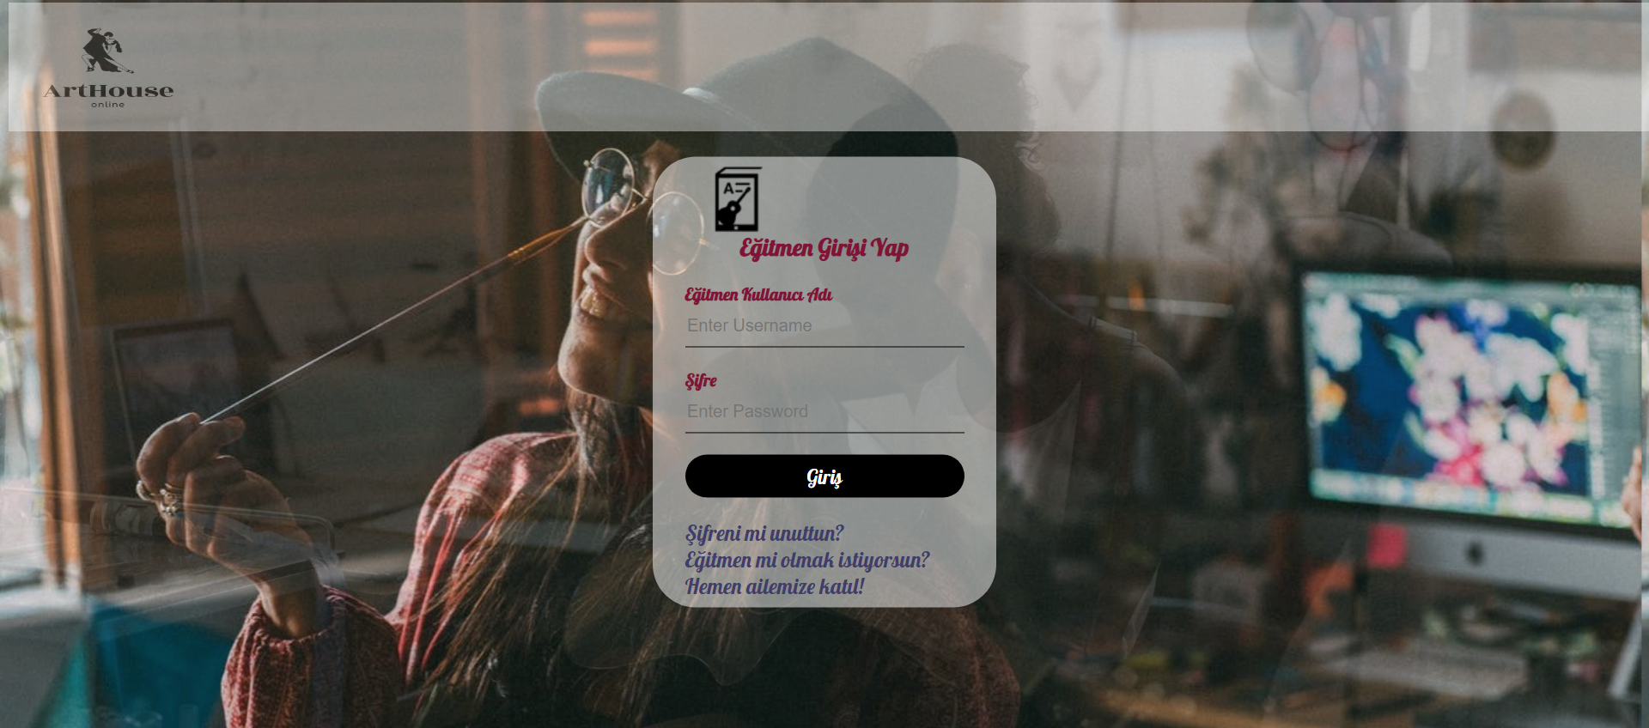
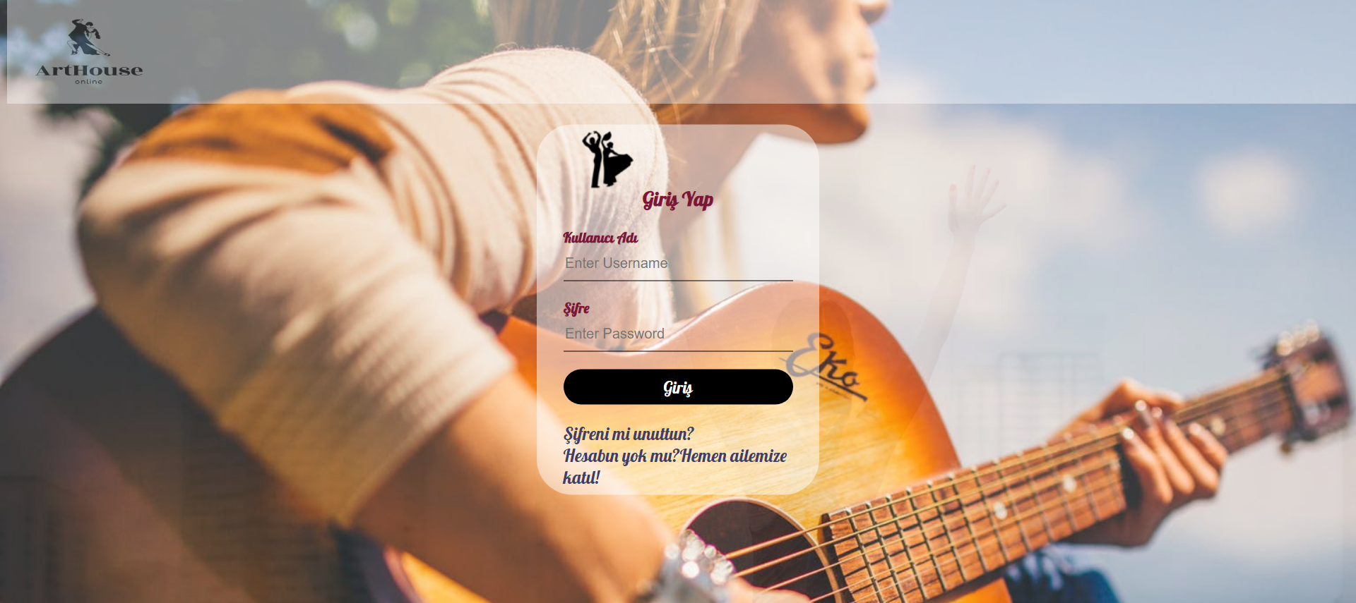

Slide 9
Product Backlog and Sprint Planning Strategies
Client requests and system requirements must be analyzed.
Analyses that have been done, must be converted to stories.
Priority and size of stories must be specified.
According to the priority and size, stories must be actualized initially.
In the interest of saving time, expectations from the product has been specified with product backlog.

Slide 10
Product Backlog and Sprint Planning Strategies
Meetings must be organized regularly. These meetings must be organized separately within the client and the team.
The tasks that team members supposed to do must be specified.
The time that given to sprints must be complied.
With the sprint planning strategy; product have broken to parts, schedules have observed and the product have obtained with higher quality.

Slide 11
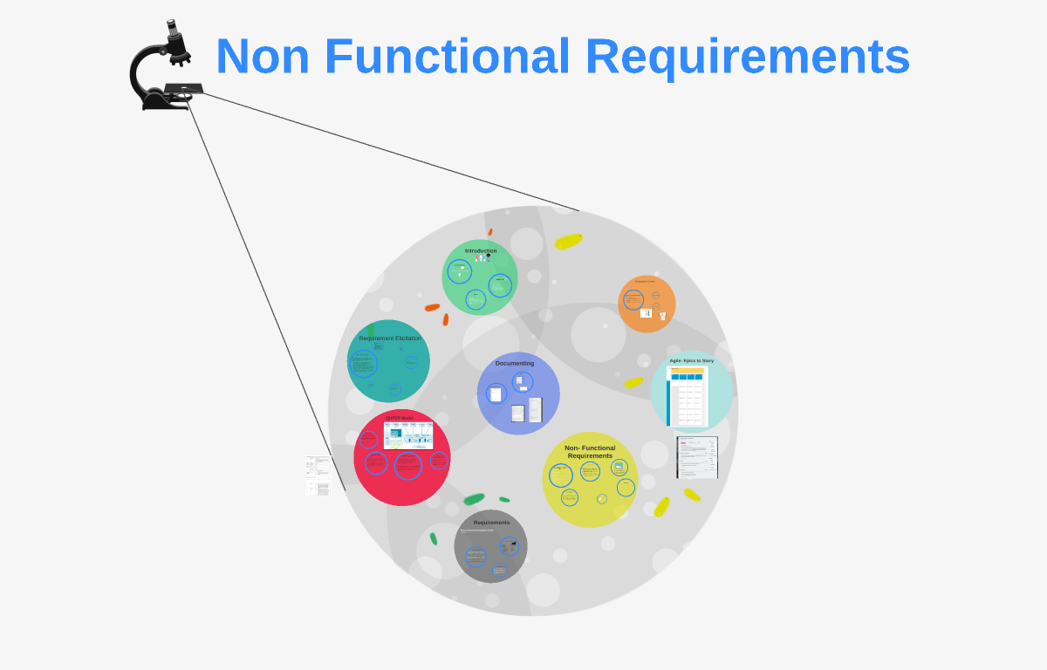
Main Non-functional Requirements
The website;
1- Shall be load fast.
2- Shall support multiple usage, and it shall not create any problem
3- Shall be accessed via tablet and phone as well as computer

Slide 12

What Have We Learned?
1- The time should be determined according to the knowledge of the team members.
2- Provide continuous contact with the customer during the planning phase.
3- Product demos must be illustrated to customer at regular intervals.
4- Team members always need each other.

Slide 13
What Have We Learned?
5- Provide continuous contact with the customer during the planning phase.
6- Client requests must be analyzed well, and the system must be improved with these requests.
7- Team members must be kept to the agreements with client.

Slide 14
Thanks for listening and attending.

